Slide 1
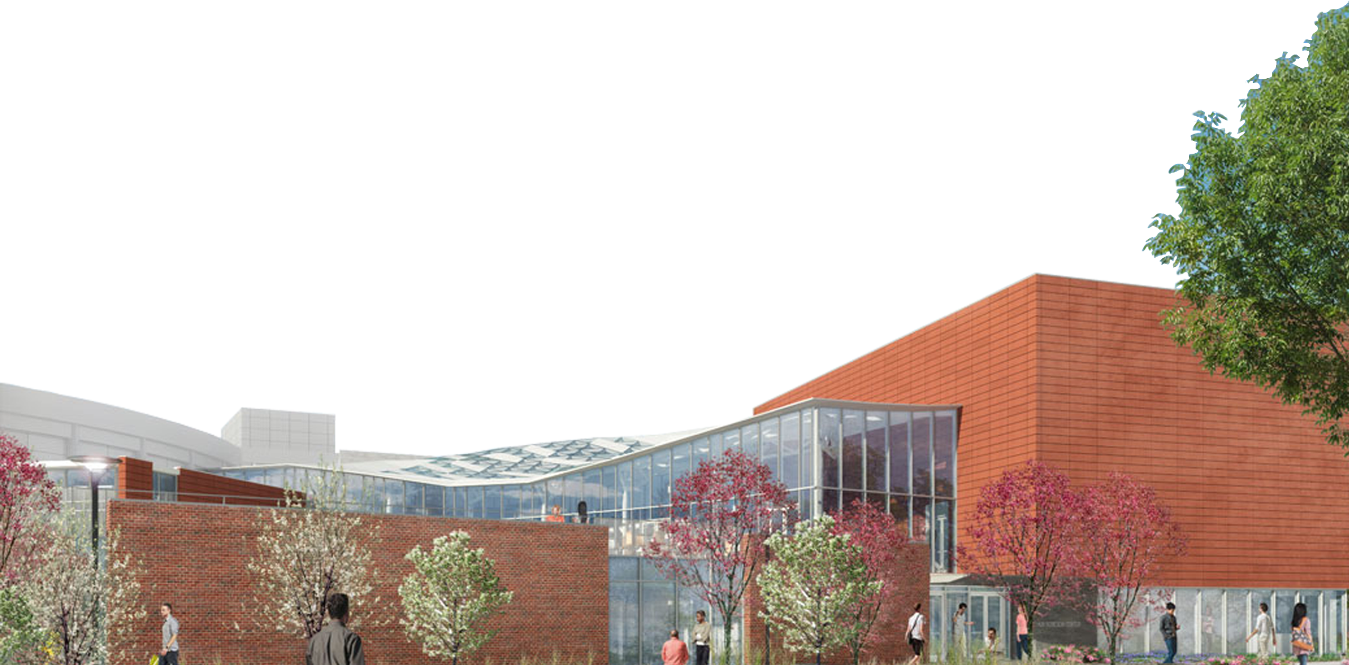
Introduction
Project Background
Analysis # 1: Terra Cotta Rain Screen Redesign
Analysis # 2: GPS Material Tracking System – Structural Steel
Analysis # 3: Removal of Habitable Green Roof Design
HUB RENOVATIONS & ADDITION
Conclusion & Recommendations
UNIVERSITY PARK, PA
Acknowledgements
The Pennsylvania State University Architectural Engineering Senior Capstone Project
Robert Justin Barlow | Construction Management Option
Advisor: Dr. Robert M. Leicht

Slide 2
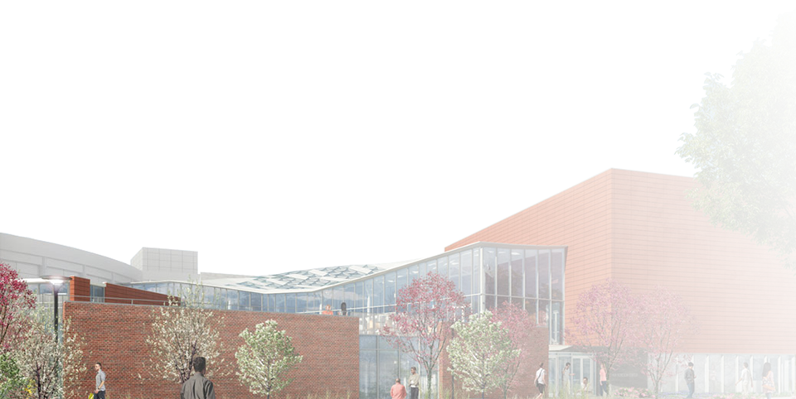
Introduction
Project Background
Analysis # 1: Terra Cotta Rain Screen Redesign
Analysis # 2: GPS Material Tracking System – Structural Steel
Analysis # 3: Removal of Habitable Green Roof Design
Project Background
Overview
Location
Project Features
Analysis #1: Terra Cotta
Overview of System
Schedule & Cost
Mechanical Breadth
Structural Breadth
Analysis #2: GPS Tracking
Just-In-Time
RFID Tracking System
Schedule & Cost
Analysis #3: Green Roof
Habitable Green Roof
Alternative Design
Carbon Footprint
Schedule & Cost
Conclusion & Recommendations
Acknowledgements
Robert Justin Barlow | AE Senior Thesis | Construction Management Option

Slide 3
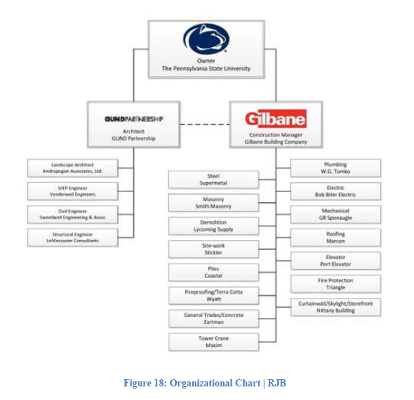
Introduction
Overview
Project Background
Overview
Building Function: Student Union Center
Overall Project Cost: $44.6 Million
Size: 40,000 GSF Renovation
64,000 GSF New Construction
Schedule: Start | May 2013
End | March 2015
Project Delivery Method: CM at Risk
Location
Project Features
Analysis # 1: Terra Cotta Rain Screen Redesign
Analysis # 2: GPS Material Tracking System – Structural Steel
Analysis # 3: Removal of Habitable Green Roof Design
Conclusion & Recommendations
Acknowledgements
Robert Justin Barlow | AE Senior Thesis | Construction Management Option

Slide 4
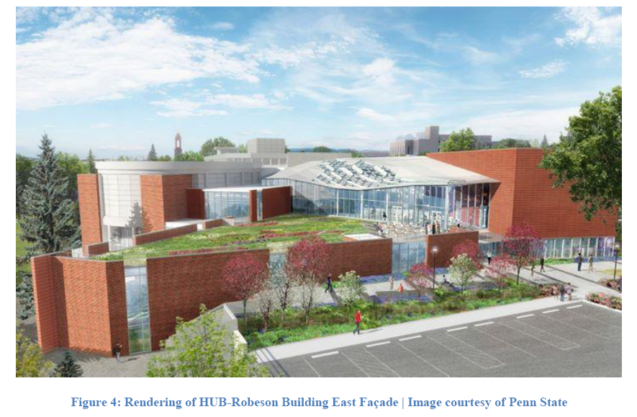
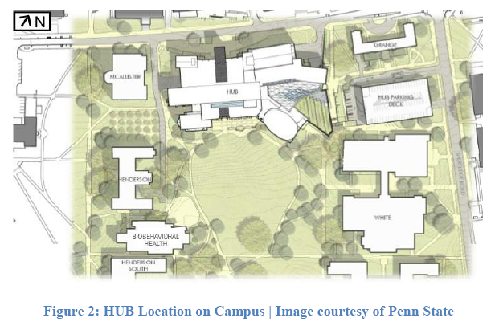
Introduction
Location
Project Features
Project Background
Overview
Location: University Park, PA
Center of Campus on East Pollock Road
Renovated Bookstore & Food Court
THON Merchandise Store
New Seating & Lounge Space
Enclosed w/ Aluminum Curtain Wall
Terra Cotta Rain Screen System
1st Habitable Green Roof on Campus
Location
Project Features
Analysis # 1: Terra Cotta Rain Screen Redesign
Analysis # 2: GPS Material Tracking System – Structural Steel
Analysis # 3: Removal of Habitable Green Roof Design
Conclusion & Recommendations
Acknowledgements
Robert Justin Barlow | AE Senior Thesis | Construction Management Option

Slide 5
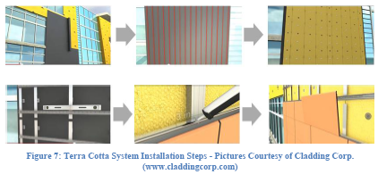
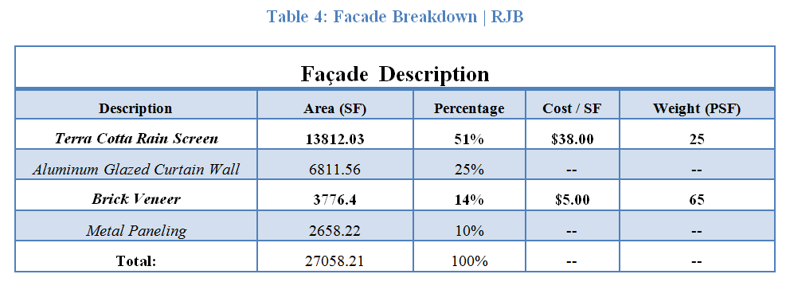
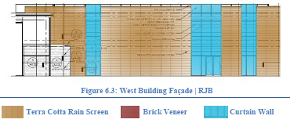
Introduction
Overview
Project Background
Analysis # 1: Terra Cotta Rain Screen Redesign
Façade Study: Nearly 51% of the exterior façade is Terra Cotta
Terra Cotta: Installation Issues
Focus: Exterior Bookstore Façade
Analysis #1: Terra Cotta Rain Screen Redesign
Overview of System
Schedule & Cost
Mechanical Breadth
Structural Breadth
Analysis # 2: GPS Material Tracking System – Structural Steel
Analysis # 3: Removal of Habitable Green Roof Design
Conclusion & Recommendations
Acknowledgements
Robert Justin Barlow | AE Senior Thesis | Construction Management Option

Slide 6
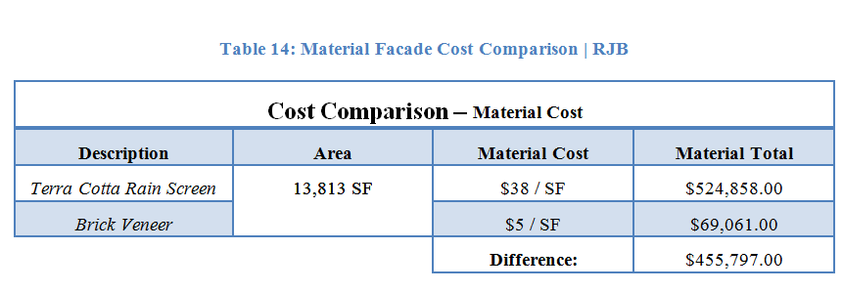
Introduction
Schedule & Cost Evaluation
Project Background
Analysis # 1: Terra Cotta Rain Screen Redesign
Schedule: 6 Day Savings
Cost: $64,142.18 Savings
Material Cost: $455,797.00 Savings (Entire Building Façade)
Analysis #1: Terra Cotta Rain Screen Redesign
Overview of System
Schedule & Cost
Overview
51% Terra Cotta Façade
Switch TC to Brick Veneer
Focus: Bookstore Exterior
Mechanical Breadth
Structural Breadth
Analysis # 2: GPS Material Tracking System – Structural Steel
Analysis # 3: Removal of Habitable Green Roof Design
Conclusion & Recommendations
Acknowledgements
Robert Justin Barlow | AE Senior Thesis | Construction Management Option

Slide 7
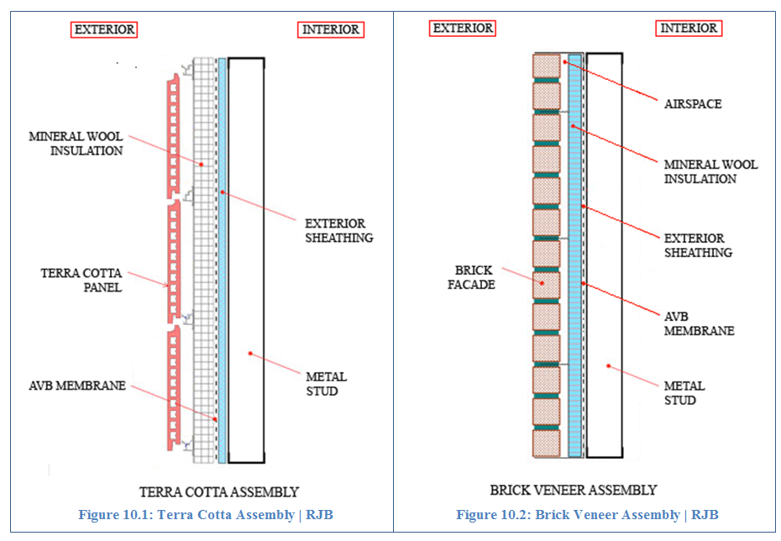
Introduction
Mechanical Breadth
Project Background
Analysis # 1: Terra Cotta Rain Screen Redesign
R-Values: HAM Toolbox
Terra Cotta: 10.32
Brick Veneer: 11.40
Simple Energy Model : DesignBuilder
Terra Cotta: 42948 kBTU
Brick Veneer: 42708 kBTU
Heat Loss Comparison: Brick Veneer 1% more efficient
Analysis #1: Terra Cotta Rain Screen Redesign
Overview of System
Schedule & Cost
Overview
51% Terra Cotta Façade
Switch TC to Brick Veneer
Focus: Bookstore Exterior
Schedule & Cost
6 Day Savings
$64,142.18 Savings
$455,797.00 Savings
Mechanical Breadth
Structural Breadth
Analysis # 2: GPS Material Tracking System – Structural Steel
Analysis # 3: Removal of Habitable Green Roof Design
Conclusion & Recommendations
Acknowledgements
Robert Justin Barlow | AE Senior Thesis | Construction Management Option

Slide 8
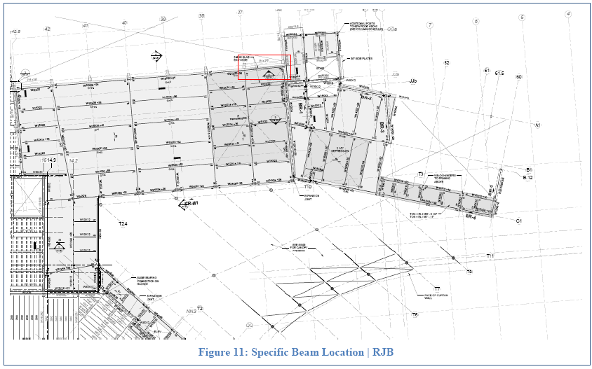
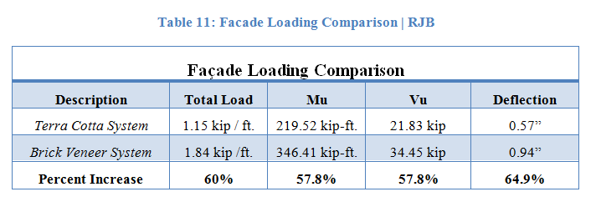
Introduction
Structural Breadth
Project Background
Analysis # 1: Terra Cotta Rain Screen Redesign
Beam Location: W21x83 2nd Floor
WebStructural Analytic Software:
Bending
Shear
Deflection
Analysis #1: Terra Cotta Rain Screen Redesign
Overview of System
Schedule & Cost
Overview
51% Terra Cotta Façade
Switch TC to Brick Veneer
Focus: Bookstore Exterior
Schedule & Cost
6 Day Savings
$64,142.18 Savings
$455,797.00 Savings
Mechanical Breadth
Structural Breadth
Analysis # 2: GPS Material Tracking System – Structural Steel
Analysis # 3: Removal of Habitable Green Roof Design
Mechanical Breadth
Similar:
R-Values
Thermal Properties
Conclusion & Recommendations
Acknowledgements
Robert Justin Barlow | AE Senior Thesis | Construction Management Option

Slide 9
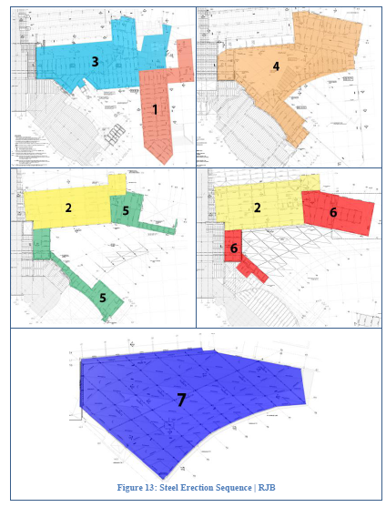
Introduction
Just-In-Time Delivery
Project Background
Analysis # 1: Terra Cotta Rain Screen Redesign
Erection Problems:
Site Congestion
Crane Issues
Just-In-Time Delivery
Weather
Tracking System Needs:
RFID Tags
Durable
Battery Life
Analysis #2: GPS Material Tracking System
Analysis # 2: GPS Material Tracking System – Structural Steel
Just – In – Time Delivery
RFID Tracking System
Schedule & Cost
Analysis # 3: Removal of Habitable Green Roof Design
Conclusion & Recommendations
Acknowledgements
Robert Justin Barlow | AE Senior Thesis | Construction Management Option

Slide 10
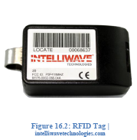
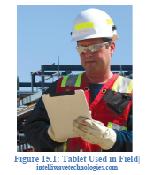
Introduction
RFID Tracking System
Project Background
Analysis # 1: Terra Cotta Rain Screen Redesign
Intelliwave Technologies:
Track: Material, Equipment, Personnel
Durable Design
Designed to Military Specs
SiteSense Material Tracking:
Web-Based Software
7 Year Battery Life
Real Time Location
Analysis #2: GPS Material Tracking System
Analysis # 2: GPS Material Tracking System – Structural Steel
Just – In – Time Delivery
Just-In-Time Delivery
Needs to:
Solve Erection Issues
Durable RFID Tracking
RFID Tracking System
Schedule & Cost
Analysis # 3: Removal of Habitable Green Roof Design
Conclusion & Recommendations
Acknowledgements
Robert Justin Barlow | AE Senior Thesis | Construction Management Option

Slide 11
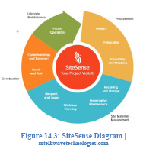
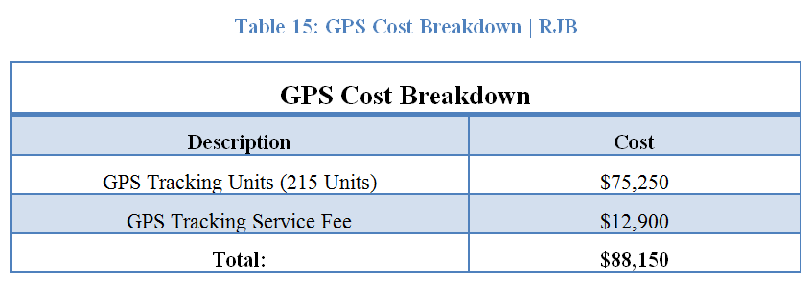
Introduction
Schedule & Cost Evaluation
Project Background
Analysis # 1: Terra Cotta Rain Screen Redesign
Schedule Benefits:
Keep Erection on Track
Quality Control
Minimize Project Delays
Cost:
215 GPS Units
$88,150.00 Additional Cost
Analysis #2: GPS Material Tracking System
Analysis # 2: GPS Material Tracking System – Structural Steel
Just – In – Time Delivery
Just-In-Time Delivery
Needs to:
Solve Erection Issues
Durable RFID Tracking
RFID Tracking System
Intelliwave Technologies
SiteSense Tracking
RFID Tracking System
Schedule & Cost
Analysis # 3: Removal of Habitable Green Roof Design
Conclusion & Recommendations
Acknowledgements
Robert Justin Barlow | AE Senior Thesis | Construction Management Option

Slide 12
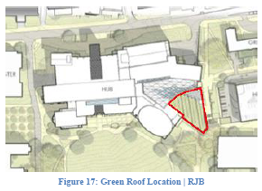
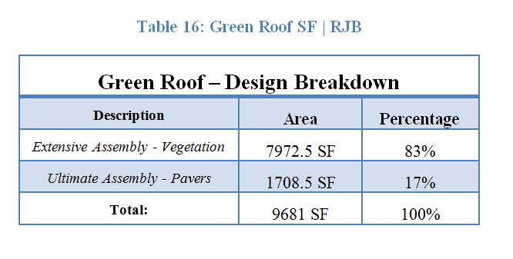
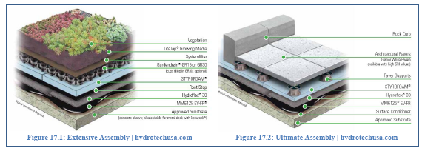
Introduction
Habitable Green Roof
Project Background
Analysis # 1: Terra Cotta Rain Screen Redesign
Analysis # 2: GPS Material Tracking System – Structural Steel
Current Design:
Extensive Green Roof Assembly
Ultimate Green Roof Assembly
17 Percent Habitable Design
Analysis #3 Removal of Habitable Green Roof Design
Analysis # 3: Removal of Habitable Green Roof Design
Habitable Green Roof
Alternative Design
Carbon Footprint
Schedule & Cost
Conclusion & Recommendations
Acknowledgements
Robert Justin Barlow | AE Senior Thesis | Construction Management Option

Slide 13
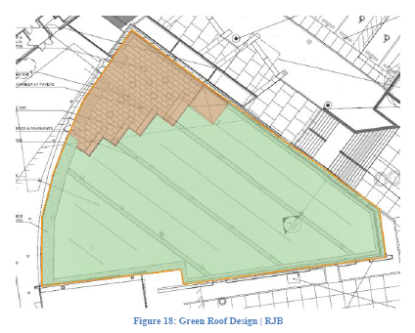
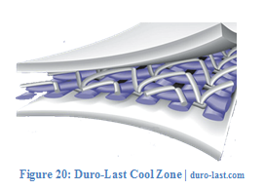
Introduction
Alternative Design
Project Background
Analysis # 1: Terra Cotta Rain Screen Redesign
Analysis # 2: GPS Material Tracking System – Structural Steel
Alternate Design:
Complete Removal of Green Roof
Duro-Last Cool Zone
Analysis #3 Removal of Habitable Green Roof Design
Analysis # 3: Removal of Habitable Green Roof Design
Habitable Green Roof
17% Ultimate Assembly
83% Extensive Assembly
Existing Bookstore Roof
Habitable Green Roof
Alternative Design
Carbon Footprint
Schedule & Cost
Conclusion & Recommendations
Acknowledgements
Robert Justin Barlow | AE Senior Thesis | Construction Management Option

Slide 14
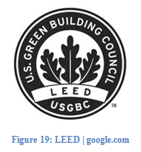
Introduction
Carbon Footprint
Project Background
Analysis # 1: Terra Cotta Rain Screen Redesign
Analysis # 2: GPS Material Tracking System – Structural Steel
Analysis #3 Removal of Habitable Green Roof Design
Analysis # 3: Removal of Habitable Green Roof Design
Carbon Offset: (Compared to black roofs)
Green Roof: 35 tons of CO₂
White Roof: 90 tons of CO₂
Green Roof Benefit:
Extensive Green Roofs: 0.5-0.8” of water retention
Heat Island Effect
Habitable Green Roof
17% Ultimate Assembly
83% Extensive Assembly
Existing Bookstore Roof
Alternative Design
Complete Removal
Duro-Last Cool Zone Assembly
Habitable Green Roof
Alternative Design
Carbon Footprint
Schedule & Cost
Conclusion & Recommendations
Acknowledgements
Robert Justin Barlow | AE Senior Thesis | Construction Management Option

Slide 15
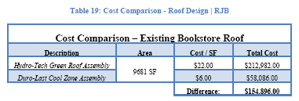
Introduction
Schedule & Cost Evaluation
Project Background
Analysis # 1: Terra Cotta Rain Screen Redesign
Analysis # 2: GPS Material Tracking System – Structural Steel
Schedule:
40 Day Savings
Green Roof: 55 Day Duration
White Roof: 15 Day Duration
Cost: $154,896.00 Savings
Analysis #3 Removal of Habitable Green Roof Design
Analysis # 3: Removal of Habitable Green Roof Design
Habitable Green Roof
17% Ultimate Assembly
83% Extensive Assembly
Existing Bookstore Roof
Alternative Design
Complete Removal
Duro-Last Cool Zone Assembly
Habitable Green Roof
Alternative Design
Carbon Footprint
Schedule & Cost
Conclusion & Recommendations
Carbon Footprint
Green Roof: 35 tons CO₂
White Roof: 90 tons CO₂
Acknowledgements
Robert Justin Barlow | AE Senior Thesis | Construction Management Option

Slide 16
Introduction
Conclusion & Recommendations
Project Background
Analysis # 1: Terra Cotta Rain Screen Redesign
Analysis # 2: GPS Material Tracking System – Structural Steel
Analysis #1: Terra Cotta
Brick Veneer Alternate Design
6 Day Savings
$64,142.18 Savings
Similar Thermal Properties
Acceptable Loading Difference
Recommendation
The Project Team should Accept
Analysis #2: GPS Tracking
Just-In-Time Delivery
Intelliwave Technologies SiteSense
215 GPS Units
Ensure Quality Control
$88,158.00 Expense
Recommendation
The Project Team should not Accept
Analysis #3: Green Roof
Complete Removal of Green Roof
Duro-Last Cool Zone
White Roof CO₂ Benefits
40 Day Savings
$154,896.00 Savings
Recommendation
The Project Team should Accept
Analysis # 3: Removal of Habitable Green Roof Design
Conclusion & Recommendations
Acknowledgements
Robert Justin Barlow | AE Senior Thesis | Construction Management Option

Slide 17
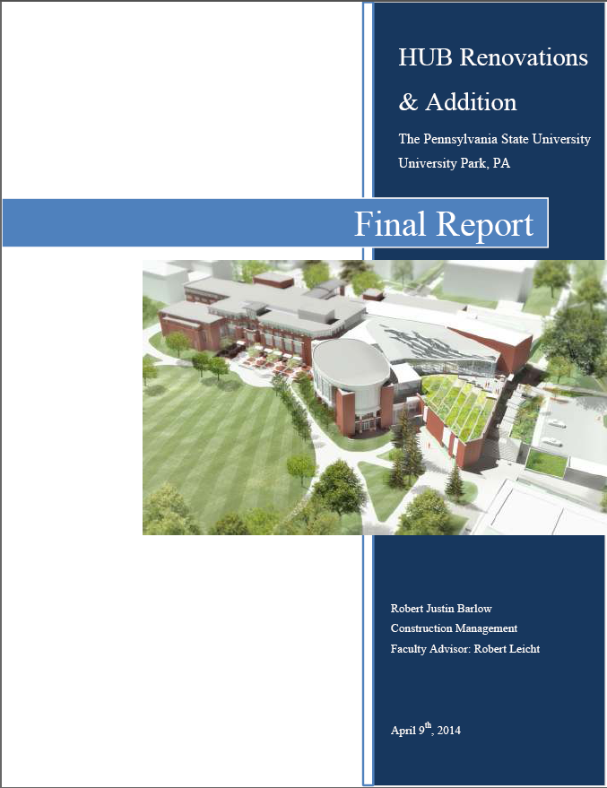
Introduction
Acknowledgements
Project Background
Analysis # 1: Terra Cotta Rain Screen Redesign
Analysis # 2: GPS Material Tracking System – Structural Steel
Academic Acknowledgments
Penn State AE Faculty & Staff
Dr. Robert Leicht
Prof. Kevin Parfitt
Ray Sowers
Special Thanks
Gilbane Project Team
Dereck Stoeckelin
Family & Friends
Analysis # 3: Removal of Habitable Green Roof Design
Conclusion & Recommendations
Acknowledgements
Robert Justin Barlow | AE Senior Thesis | Construction Management Option

Slide 18
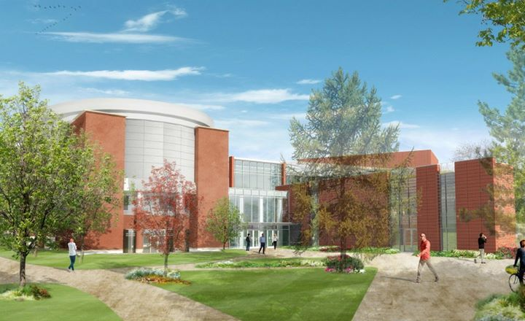
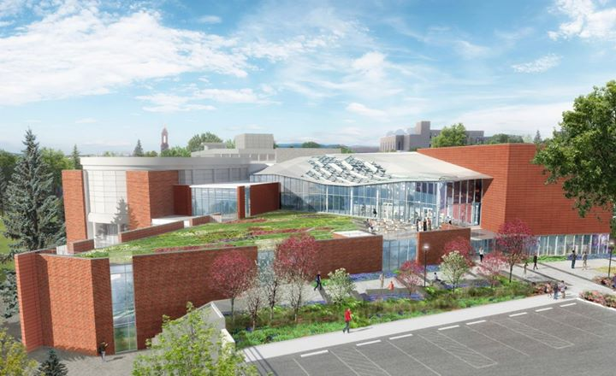
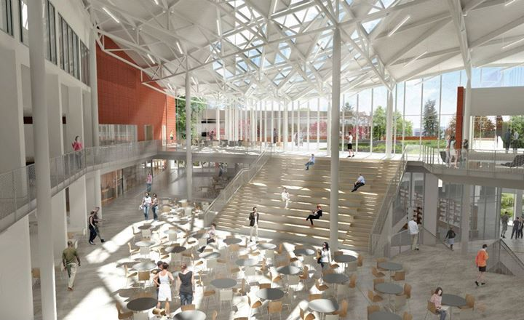
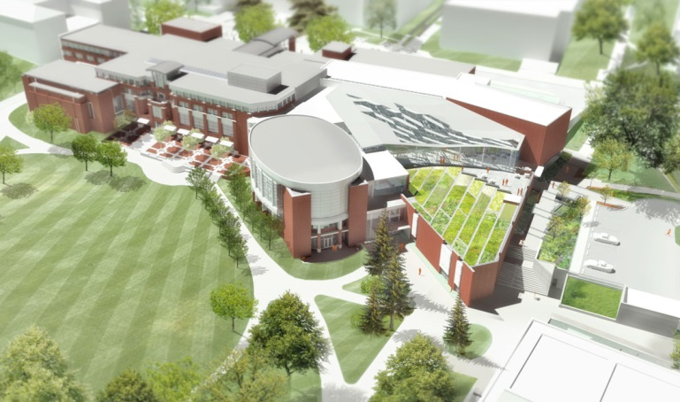
Introduction
Project Background
Analysis # 1: Terra Cotta Rain Screen Redesign
Analysis # 2: GPS Material Tracking System – Structural Steel
Analysis # 3: Removal of Habitable Green Roof Design
HUB RENOVATIONS & ADDITION
Conclusion & Recommendations
UNIVERSITY PARK, PA
Acknowledgements
The Pennsylvania State University Architectural Engineering Senior Capstone Project
Robert Justin Barlow | Construction Management Option
Advisor: Dr. Robert M. Leicht

